Slide 1
The unit modeler platform
A new paradigm for intelligent computing
Copyright © Ke Labs, Inc. 2017

Slide 2
Introduction

Slide 3
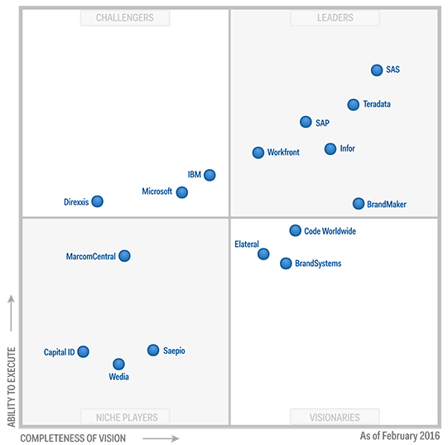
The Information Era
Two Phases
Data generation
Data consumption
Gartner Magic Quadrant

Slide 4
Ke Labs Mission & Vision
“To advance intelligent computing”
The Unit Modeler platform
Self-service analytics & business intelligence
Application development
Ecosystem of integrated resources

Slide 5
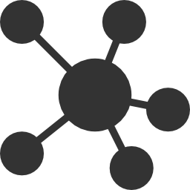
Unit Modeler® Vision
Collection → Insight → Dissemination → Use
Information Center
Research & discovery tools
Application creation
Workspaces
Distribution & archival of reports, queries, documents and apps
Applications
Healthcare professionals for patient care
Lifecycle of Knowledge

Slide 6
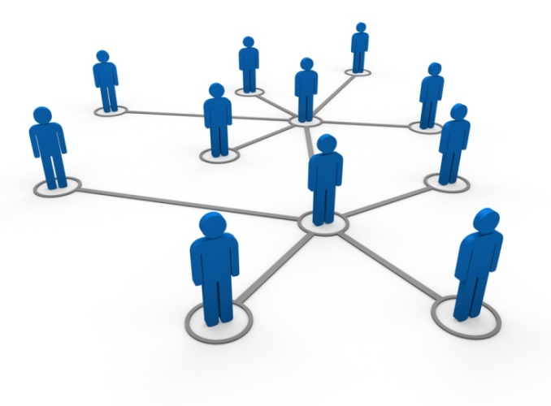
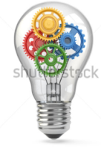
The Unit Modeler Platform Vision
Collect → Discover → Create → Archive →Distribute → Use
Tools for Research / Discovery
Application Creation
Information Center
Healthcare professionals for patient care
By operations, administration, accounting…
Researchers
Applications
Archival and Distribution of
Reports, Queries, Documents and Applications
Workspaces
Lifecycle of Knowledge

Slide 7
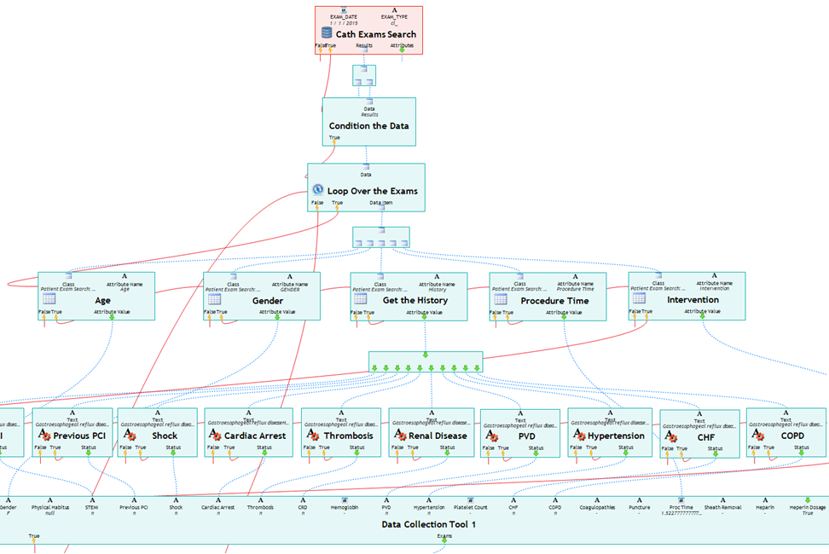
Unit Modeler® Information Center
Harnessing the Power of Information
All-in-one toolkit for capturing data to drive actionable insights and efficient operations
Medical Research Execution
Process data rapidly and accurately
Automated Data Processing
Remove manual steps in data preparation
System Migration
Simplify complex tasks of data migration

Slide 8
The Unit Modeler® Platform
Brief Tour

Slide 9
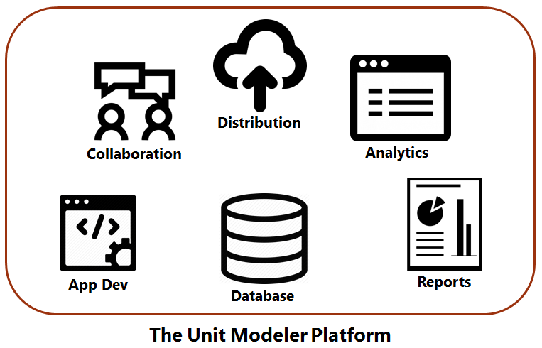
Unit Modeler Platform
An expanding set of interconnected tools

Slide 10
The Unit Modeler Platform A System of Interconnected Components
Technology Area | Unit Modeler Component
Databases | Query Builder, Database Manager
Analytics, Data Visualization | Data Analyzer, Visual Workbench
Reports | Report Builder
Application Building | Information Unit Model, ISDE
Distribution of Material | Workspaces, Subscription Manager, Servers
Collaboration / DevOps | Workspaces
Reuse / Components | The Information Unit Model
All based on a common platform

Slide 11
User Continuum
Advanced User / Ke Labs
Custom Operations / Modeling
Advanced Reports
Analytic Operations and Algorithms
Power User
Designing Reports
Visual Analytics Workbench
Query Builder
Moderate User
Graphs
Data Analyzer
Run Existing Reports
Everyone
Run Existing Form Queries
Workspaces

Slide 12
Information Center
Toolkit to access, analyze and report on information within databases
Query Builder
Data Analyzer
Visual Analytics Workbench
Report Creator
Library

Slide 13
Data Analyzer
An application for analytics, data mining and data manipulation

Slide 14
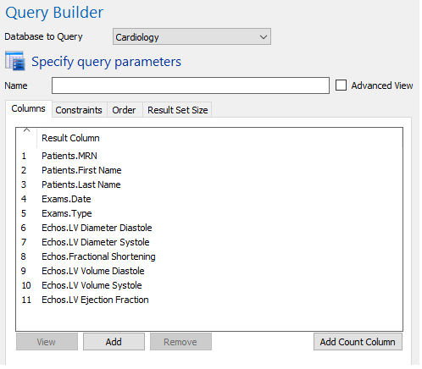
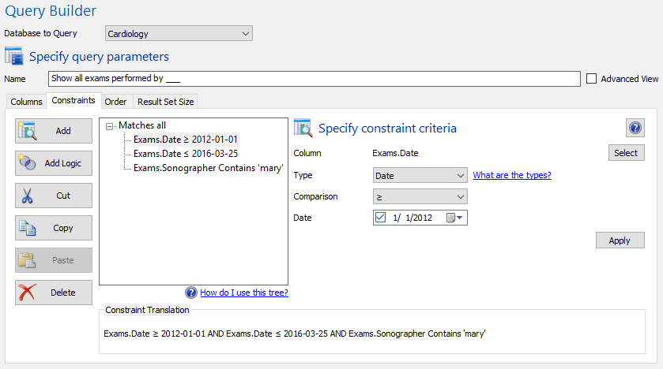
Query Builder
A point and click tool for creating queries. No knowledge of SQL or database concepts is required. Implements many of the advanced features of SQL, such as sub-queries, statistics, lists of constraint values, distinct queries, and more.

Slide 15
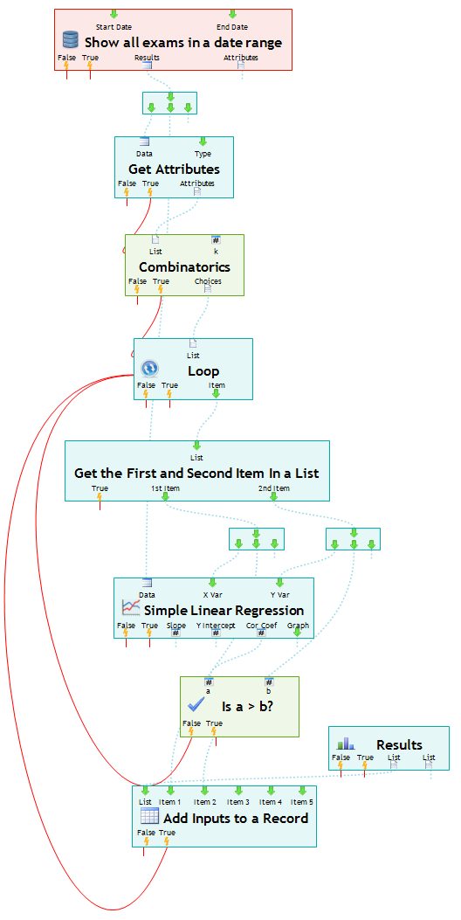
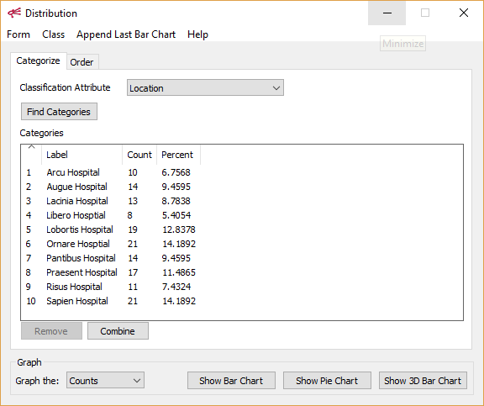
Visual Analytics Workbench
Query Builder
Simple Linear Regression Tool
Build flow diagrams of unlimited complexity composed of queries, data manipulation operations, looping structures, natural language tools, math, statistics, data mining, and more.

Slide 16
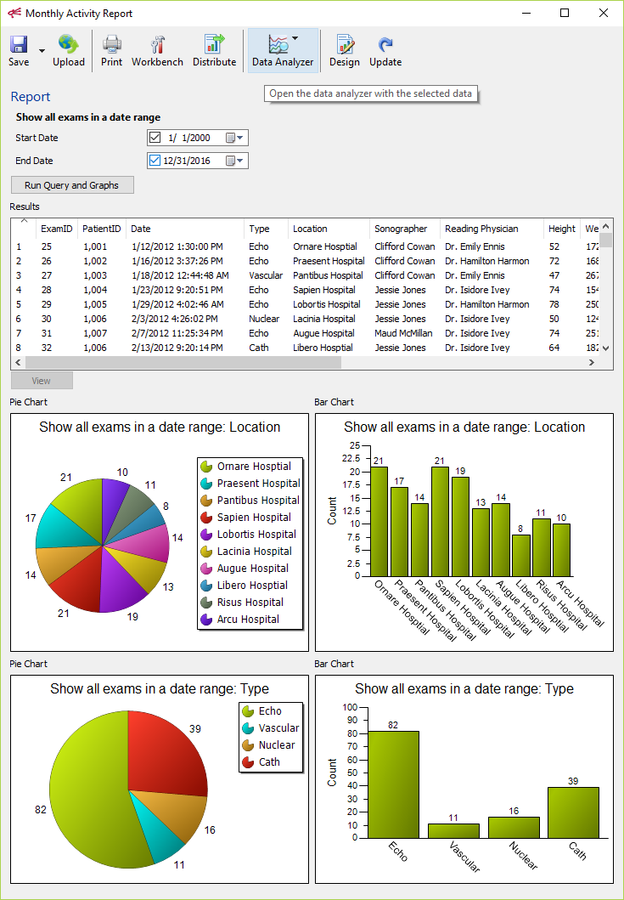
Reports
Reports can display any pieces of a visual analytics algorithm. Design is easy with a point-and-click Report Builder.

Slide 17
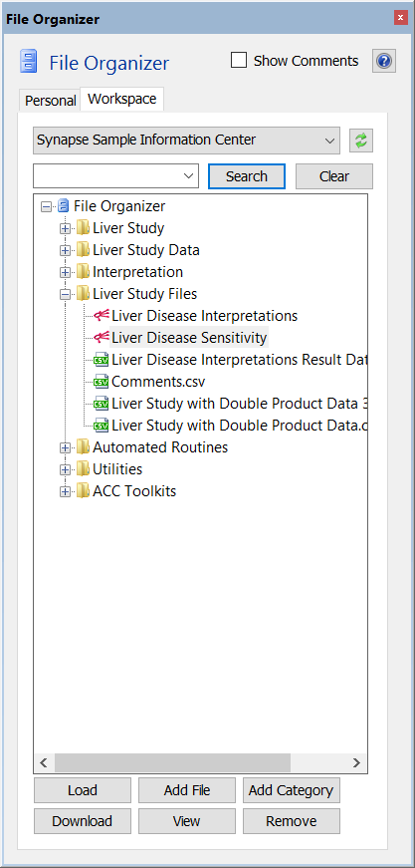
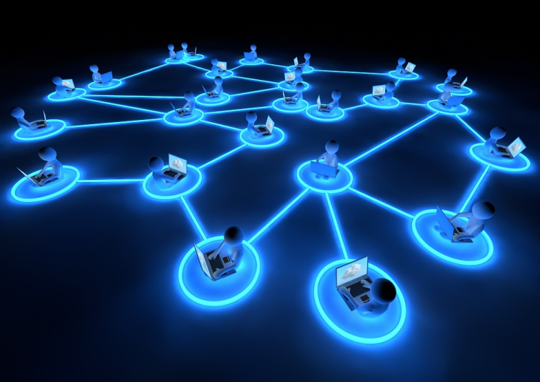
Workspaces
Save and share all
of your work
Private, Public
Owner
Members
Dependencies
File Storage
Project Management
Collaboration
Application Distribution
Workspaces create an ecosystem of interacting, actionable knowledge

Slide 18
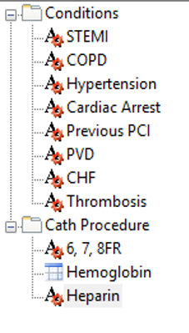
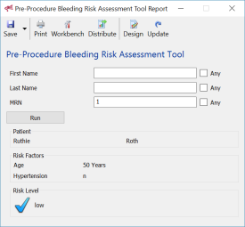
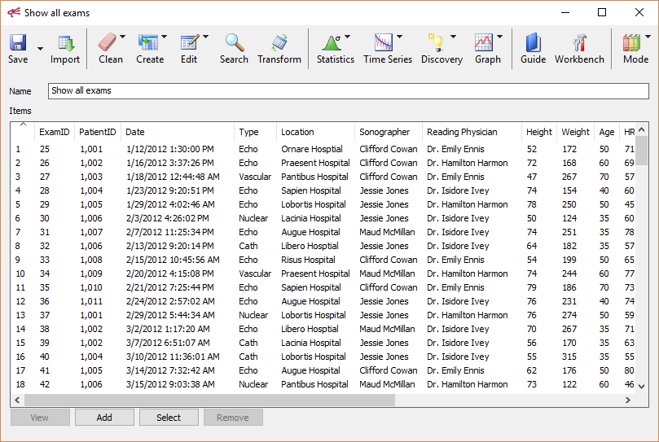
Workspaces
Everything created can be stored in a Workspace
Workspace

Slide 19
Workspaces Browser
Workspaces that are designated as public will appear in the Workspace browser. The areas on the left side can be customized for each site. The Workspace Browser provides a mechanism to share resources amongst members of your organization.

Slide 20
The Unit Modeler Desktop
The Desktop contains links to all the workspaces to which you are a member

Slide 21
Use Case
Predictive Modeling Tools
For NCDR

Slide 22
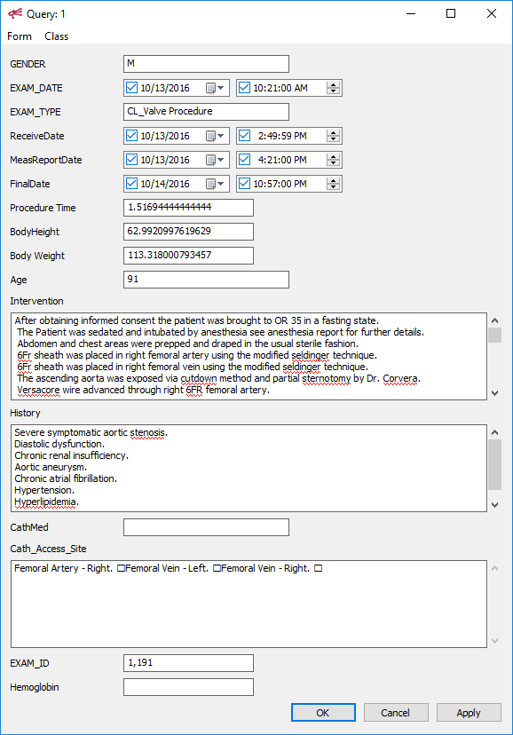
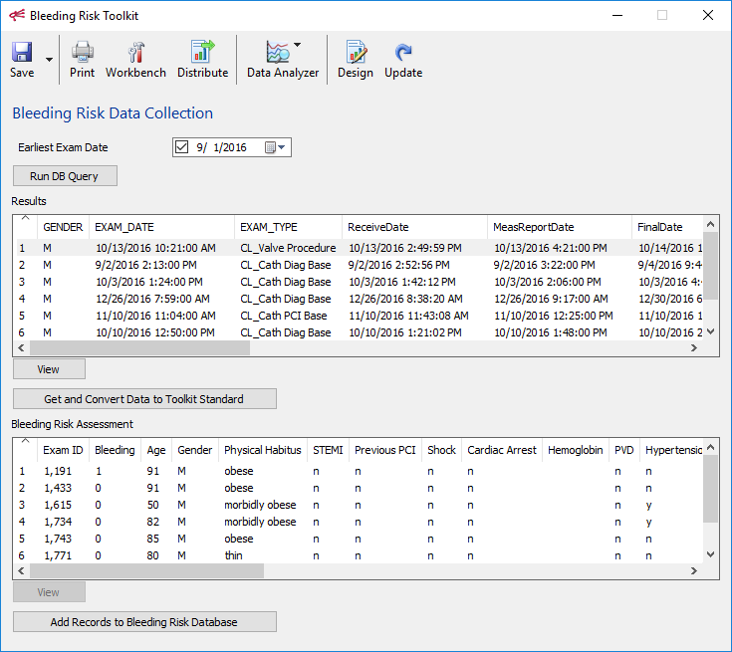
Data Collection Bleeding Risk Assessment Toolkit
The Bleeding Risk application queries the Synapse data (and Cerner in the future) and then normalizes the data into ACC’s desired format. The normalization algorithm is shown on the next slide.

Slide 23
Data Collection
Site
Data
Map Site Data
(manual)
Third Party SW
Send to ACC

Slide 24
Time Savings for Record Processing
1 second per exam
30 minutes per exam

Slide 25
Cost Savings for Record Processing
To process 1 study (traditional)
Development = 3 days
30 minutes x 1,000 exams = 93 days
93 days x 8 hours x $50/hr = 10s of thousands!
Modify and run algorithm anytime
Accommodates changes with ease
Processes in fraction of time

Slide 26
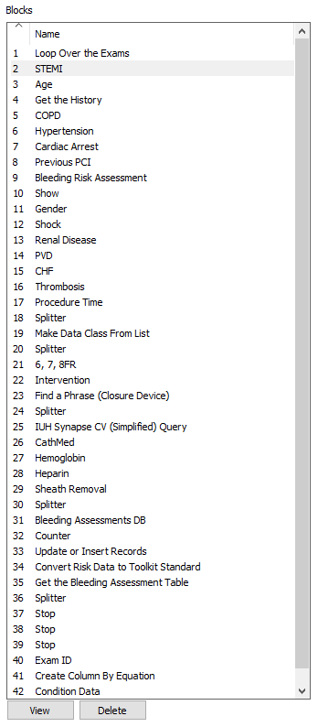
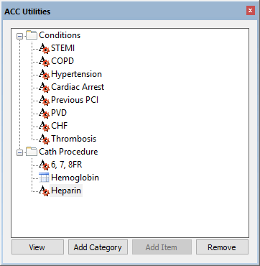
Reusable Components
Reusable components stored in library – new tools are faster to create

Slide 27
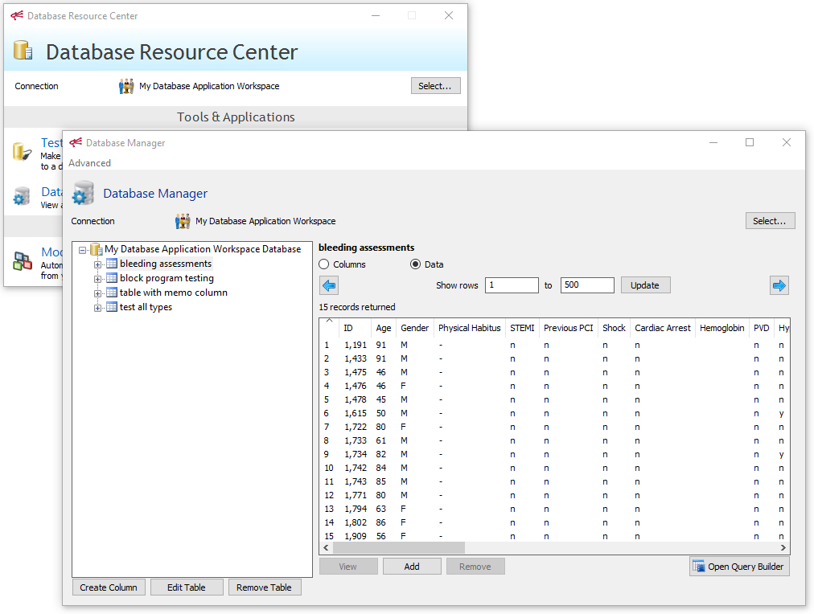
Database Results
The Unit Modeler has the ability to create, manage and write data to databases.

Slide 28
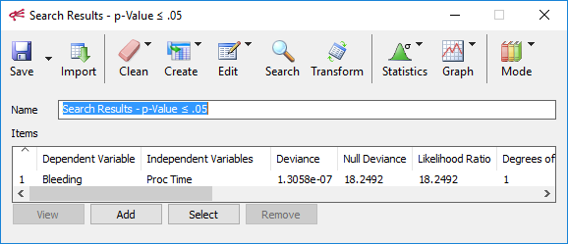
Discovery
Automated Logistic Regression
Find all factors predictive of bleeding with p-Value < .05

Slide 29
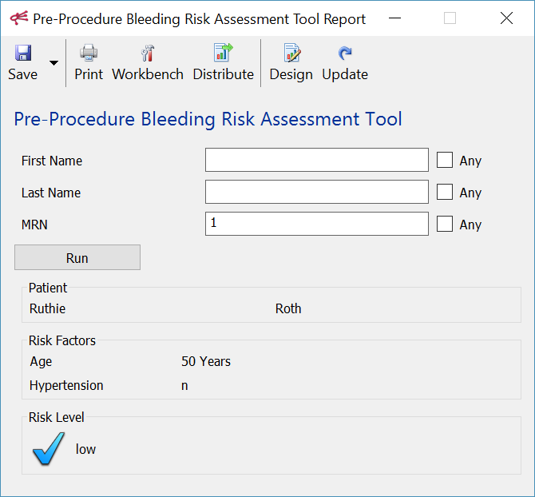
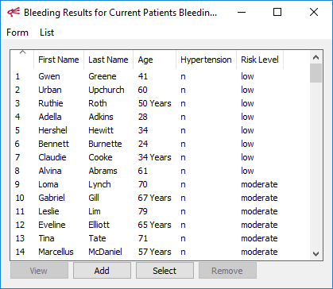
Create an Application
A simple application that makes use of a regression result. The Hypertension tool was reused from a previous algorithm. A more advanced version of this tool could be run on all scheduled patients with the results written to a database or sent directly to care givers.

Slide 30
Use Case
Customized Research

Slide 31
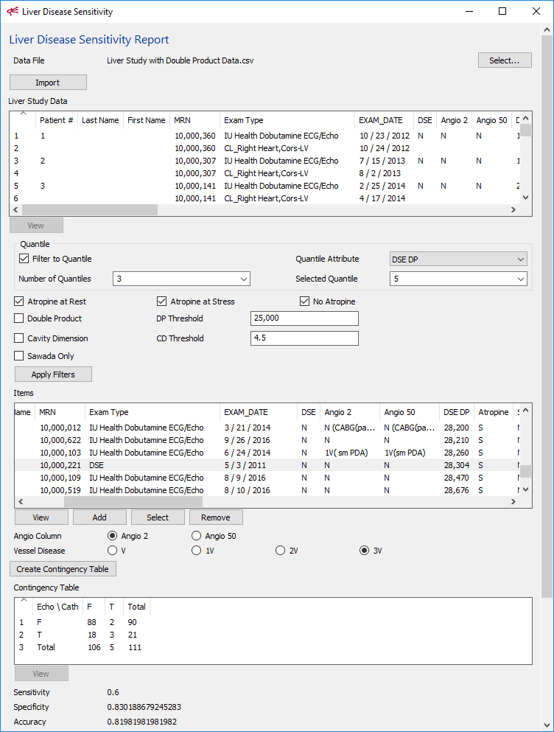
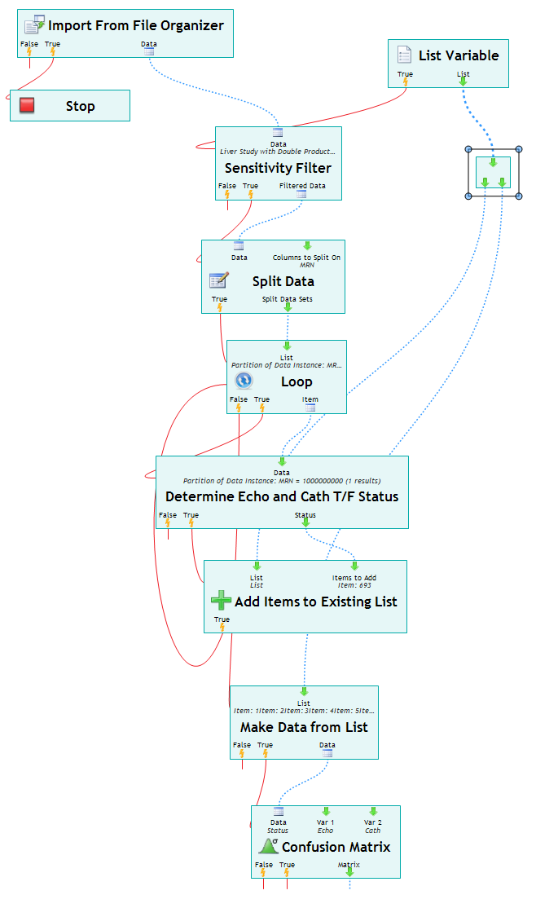
Custom Discovery
Liver study report customized for IUH. The available options save many hours of time and allow exploration of questions which might otherwise be impractical.

Slide 32
Other Items

Slide 33
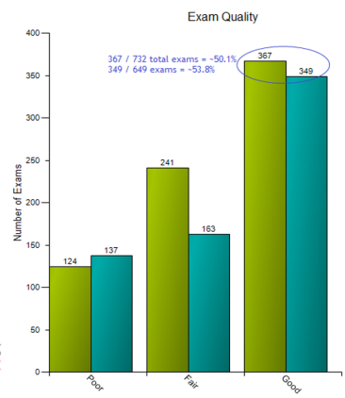
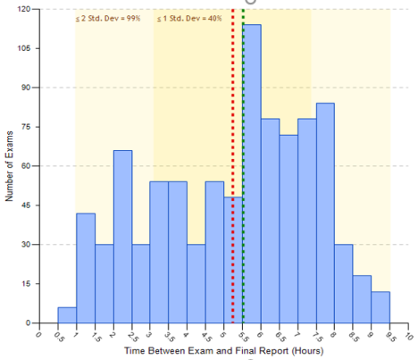
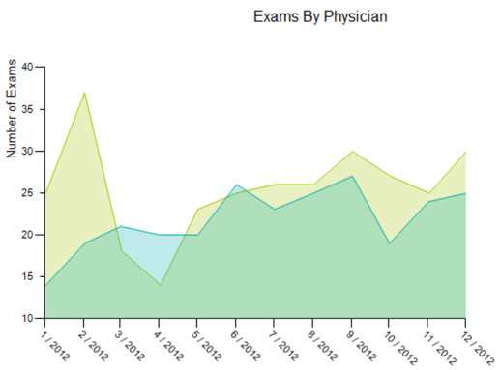
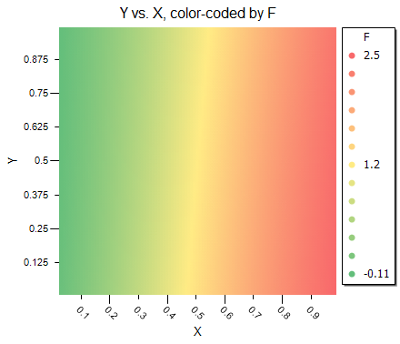
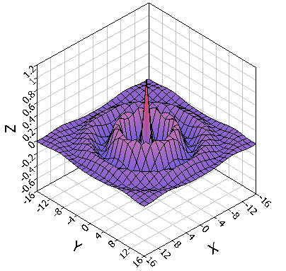
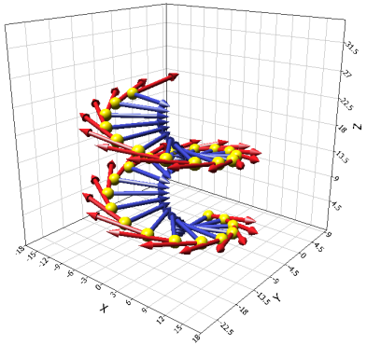
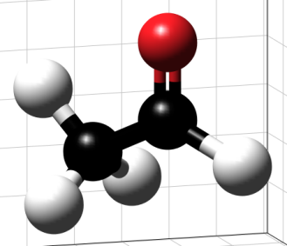
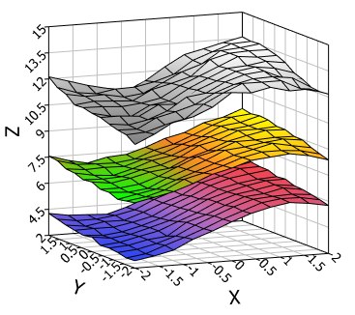
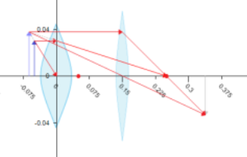
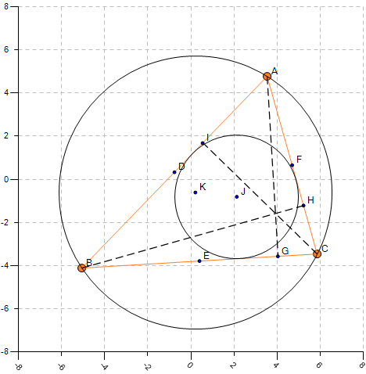
Graphs and Visualizations

Slide 34
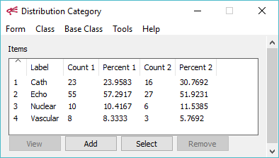
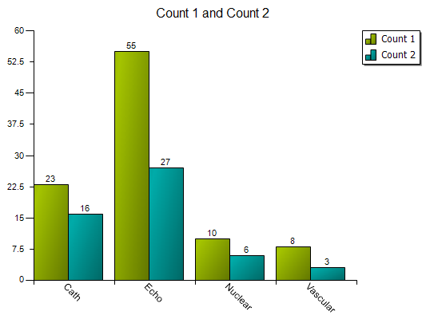
Merging Data
Merging the results of separate operations

Slide 35
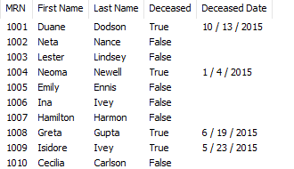
Merging Data
Example: MRN
Combine data sets according to any number of unique identifiers

Slide 36
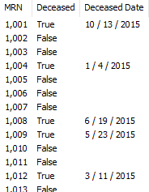
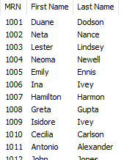
Merging Data from Different Sources
Algorithm to merge data from cardiology database with data from EHR

Slide 37
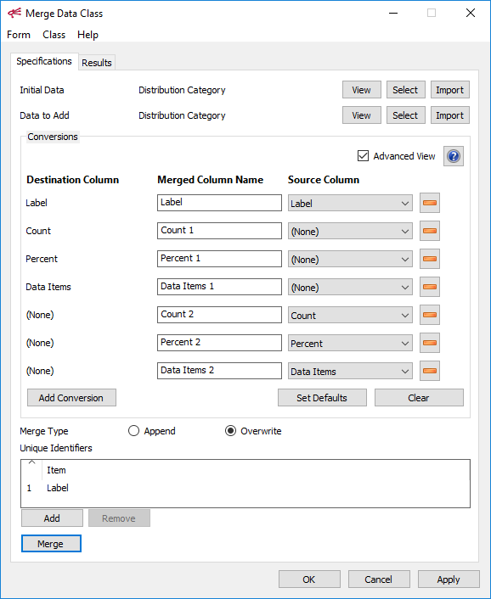
Merging Data
Provides flexibility to handle many different types of merge operations

